Slide 1

Project Presentation
Prediction of Air Quality Index for Mumbai Region: A Machine Learning Approach
Under Supervision of
Dr . Indrajeet kumar
Assistant Professor
PRESENTED BY:
Rahul kumar Mahato
Masters in Data science & Applied statistics
EnRoll No - CUSB2302222005
SEMESTER - III
[SESSION: 2023-2025]
𝕯𝖊𝖕𝖆𝖗𝖙𝖒𝖊𝖓𝖙 𝖔𝖋 𝕾𝖙𝖆𝖙𝖎𝖘𝖙𝖎𝖈𝖘
SCHOOL OF MATHEMATICS, STATISTICS AND COMPUTER SCIENCE
Central University of South Bihar , Gaya

Slide 2
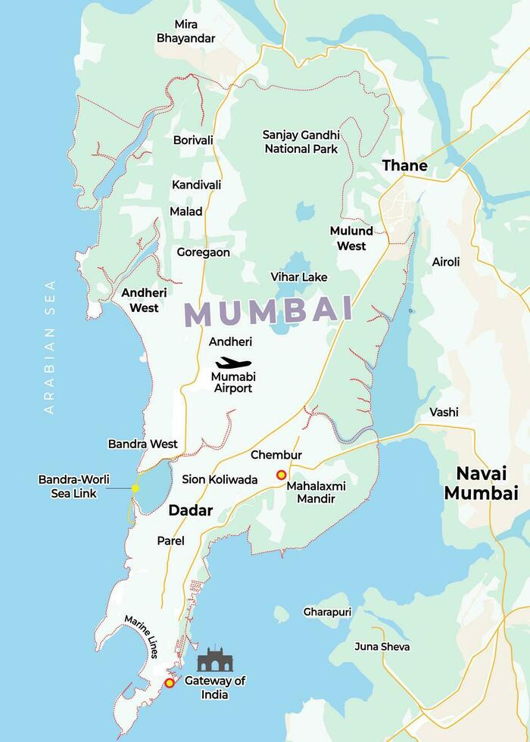
Prediction of Air Quality Index for Mumbai Region: A Machine Learning Approach

Slide 3
Objective
.
Mumbai faces ongoing air pollution challenges due to rapid urbanization, dense population, and industrial activity. The primary objective of this project is to analyze and predict the Air Quality Index (AQI) in Mumbai using machine learning algorithms.
.
Iterative approaches to corporate strategy
Establish a management framework from the inside
By identifying patterns in pollutant concentrations and weather data, this project aims to forecast Air Quality Index levels accurately and provide insights into reducing pollution in the city. This model will serve as a tool to inform make decisions, enhance pollution control measures, and improve public health in Mumbai.

Slide 4
Mumbai Air Pollution
Moreover, as one of India’s busiest cities for tourism and business, Mumbai’s air pollution can leave a lasting negative impression on visitors while affecting the quality of life for its residents.
Mumbai, spanning an area of 603.4 km², is located on the western coast of India, along the Arabian Sea, with a latitude range from 18.887 to 19.271°N and a longitude range from 72.775 to 72.978°E. Governed by the Maharashtra state government and the Brihanmumbai Municipal Corporation (BMC), Mumbai is the financial capital of India and one of the most densely populated cities globally. As of the 2011 census, it is home to approximately 12.4 million residents, making it the most populous city in India. This dense population, along with rapid urban and economic development, has led to significant air quality challenges in the city.

Slide 5




Methodology The project will involve the following steps
Data Preprocessing
Model Development
Model Evaluation &
Feature Importance
Pred…

Slide 6
Data collection :
Data collection for this project involved gathering historical air quality data specific to the Mumbai region from the Central Pollution Control Board (CPCB) of India. The CPCB is the primary government body responsible for monitoring and regulating air quality across the country. Data was accessed through the CPCB’s online portal, specifically the "Central Control Room for Air Quality Management - All India" [10] under the "Data Repository" section .
To obtain the data for this analysis, the following parameters were selected:
Data Type: Raw data (Raw)
Frequency: 1-day intervals
State: Maharashtra
City: Mumbai
Monitoring Stations: All available monitoring stations within Mumbai
Time Period : 2021-2023

Slide 7
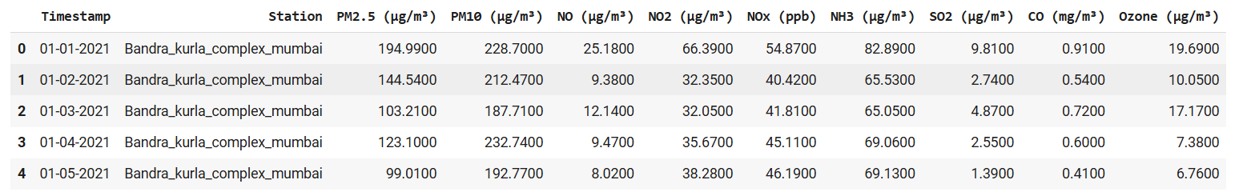
Data
The data set contains air quality data and AQI of various cities in India. The raw data set contains 21,900 rows, 11 columns . The data set contains following variables particulate matter 2.5, particulate matter 10, nitric oxide, nitric dioxide, nitric x-oxide, ammonia, carbon monoxide, sulphur dioxide. The sample of "air quality data in India (2021- 2023) data set is shown below.
Figure : Sample of air quality data for Mumbai region

Slide 8






Data preprocessing steps:
Data Cleaning
Remove or fill in missing or inconsistent data points to ensure the dataset is complete and ready for analysis.
Scale the data so that all features have comparable ranges, improving the performance of machine learning algorithms.
Feature Selection
Normalization
Identify the most important variables (e.g., pollutants like PM2.5, PM10, and weather conditions) that contribute to AQI prediction, and remove less relevant features.
Handling Outliers
Train-Test Split
Detect and address extreme values (outliers) that could distort the model’s learning process.
Divide the dataset into training and testing sets to evaluate the model’s performance on unseen data.
Data Transformation
Apply techniques like encoding categorical variables or creating new features from existing ones to enhance the dataset's usability and relevance for the model.

Slide 9
Handling Missing Values :
Data Quality and Missing Values: The initial dataset contained missing values across several key pollutants and meteorological parameters, as summarized below:
Timestamp: 0 missing values
Station: 0 missing values
PM2.5 (µg/m³): 2,347 missing values
PM10 (µg/m³): 2,374 missing values
NO (µg/m³): 2,453 missing values
NO2 (µg/m³): 2,342 missing values
NOx (ppb): 2,328 missing values
NH3 (µg/m³): 2,565 missing values
SO2 (µg/m³): 2,916 missing values
CO (mg/m³): 2,346 missing values
Ozone (µg/m³): 2,907 missing values

Slide 10
Data Cleaning Process: A Hierarchical Imputation Approach
To address missing values in the air quality dataset, a hierarchical imputation strategy was employed. This approach leverages temporal patterns and spatial similarities to fill in gaps in the data while preserving the underlying structure.
Step 1: Quarterly Grouping and Imputation
The data was initially grouped by Station, Year, and Quarter to capture seasonal variations and local trends. Imputation with Similar Stations: Missing values within each quarter were filled using the mean values of similar stations during the same quarter.
Figure : Missing values in after Quarterly Grouping and Imputation

Slide 11
Step 2: Semester Imputation : For remaining missing values after the quarterly imputation:
Data Grouping: The data was grouped by Station and Year into six-month periods (semesters).
Imputation: Missing values within each semester were filled using the mean values of the same station during that semester. This approach leverages the temporal pattern within a year to infer missing values.
Figure 3.3.2: Missing values in after Semester Imputation
Step 3 : 9-Month Period Grouping and Imputation .To address remaining missing values, a broader 9-month period was considered. This wider window allows for more data points to be used for imputation, especially in cases where quarterly data was insufficient.
Figure : Missing values in after 9-Month Period Grouping and Imputation
The hierarchical imputation strategy provides a robust and effective method for handling missing values in air quality datasets

Slide 12
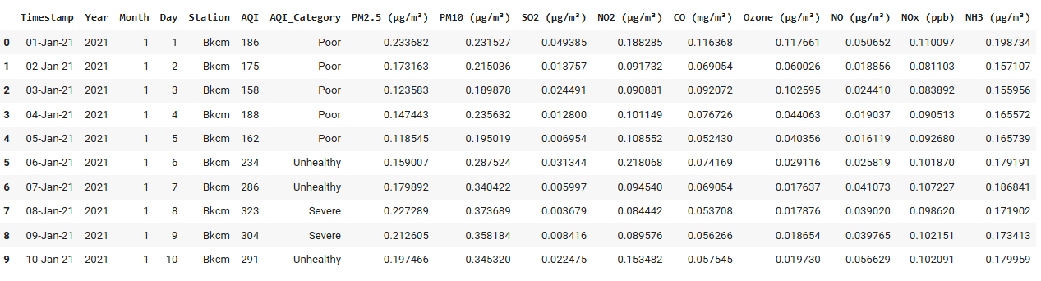
AQI Calculation
After cleaning the dataset and addressing missing values, an additional column, Calculated AQI, was added to represent the Air Quality Index (AQI) for each day and station. The AQI was computed using the AQI Calculator ( version: aqi_calculator_v2-2021.10.03.xlsm), a tool that calculates AQI based on India's AQI breakpoint information provided by the Central Pollution Control Board (CPCB).
Data Normalization and Scaling
Figure :Final preprocessed AQI Data set

Slide 13
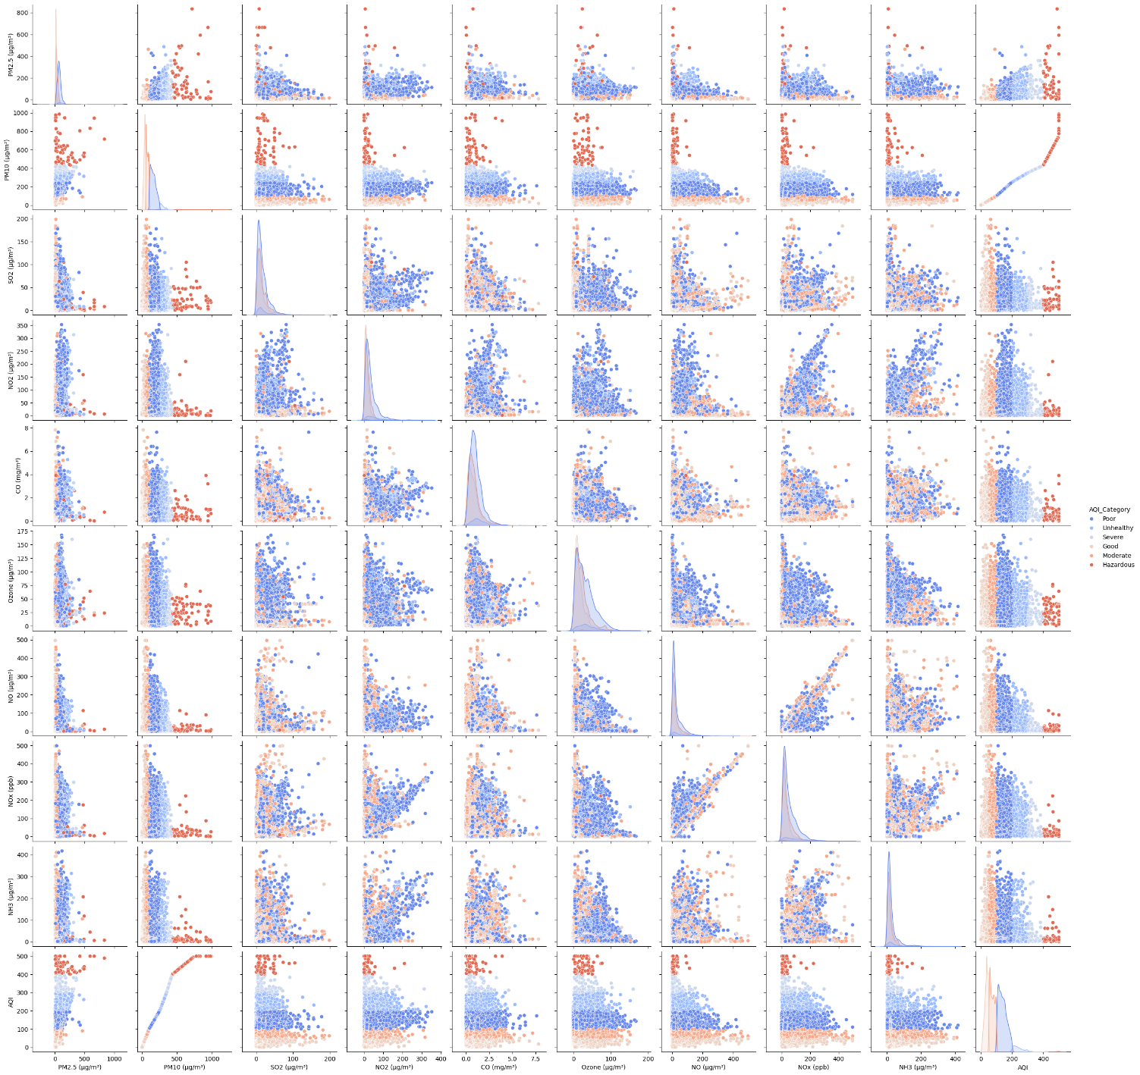
Exploratory Data analysis
Data Visualization: Data visualization is the graphical representation of data using visual elements like charts, graphs, maps, and plots.
In the context of an AQI prediction project, data visualization involves creating visual representations of air quality data (e.g., pollutant concentrations, meteorological factors, temporal trends) to uncover patterns, relationships in the data.
Figure Correlation plot Using pairplot

Slide 14
This pairplot now shows the relationships between variables colored by AQI_Category, which adds another dimension to our analysis:
Color Distribution:
The points are colored based on AQI categories (Good, Moderate, Poor, etc.) This helps visualize how different pollutant combinations relate to air quality categories
Relationships:
PM2.5 vs PM10: Shows strong positive correlation with higher AQI categories (warmer colors) clustering in the upper right
NO vs NOx: Clear positive correlation with AQI categories showing distinct clustering
PM2.5/PM10 vs AQI: Higher values correspond to worse AQI categories, showing direct influence on air quality
Pollutant Patterns:
Higher concentrations of PM2.5, PM10, and NOx tend to correspond with worse AQI categories.
Ozone shows more mixed distribution across AQI categories
CO shows some clustering of higher AQI categories at higher concentrations

Slide 15
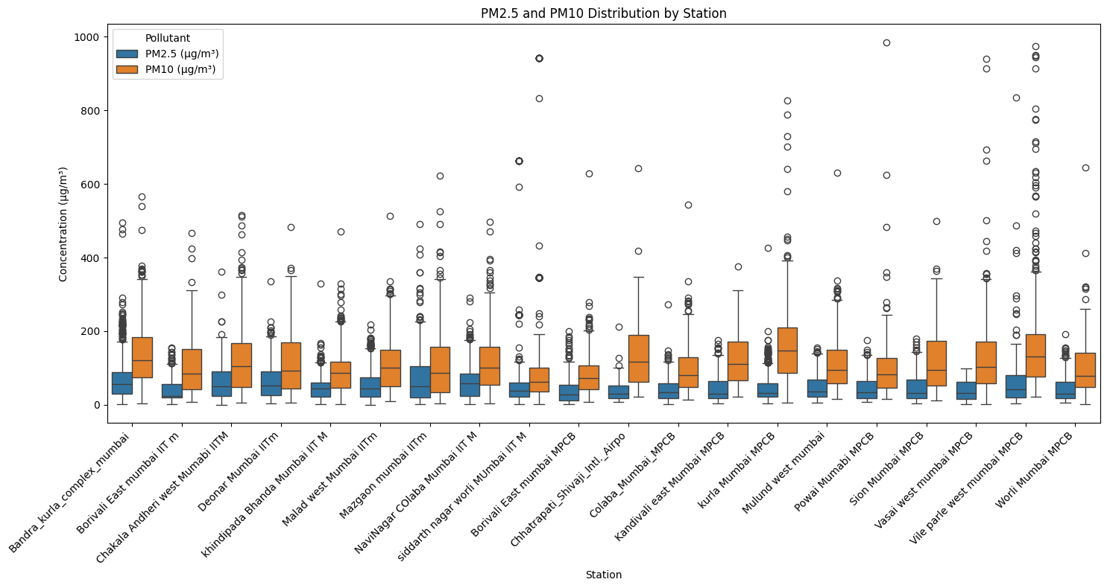
Boxplot for visualization of PM distributions across stations
we can observe:
PM10 levels (orange boxes) are consistently higher than PM2.5 levels across all stations.

Slide 16
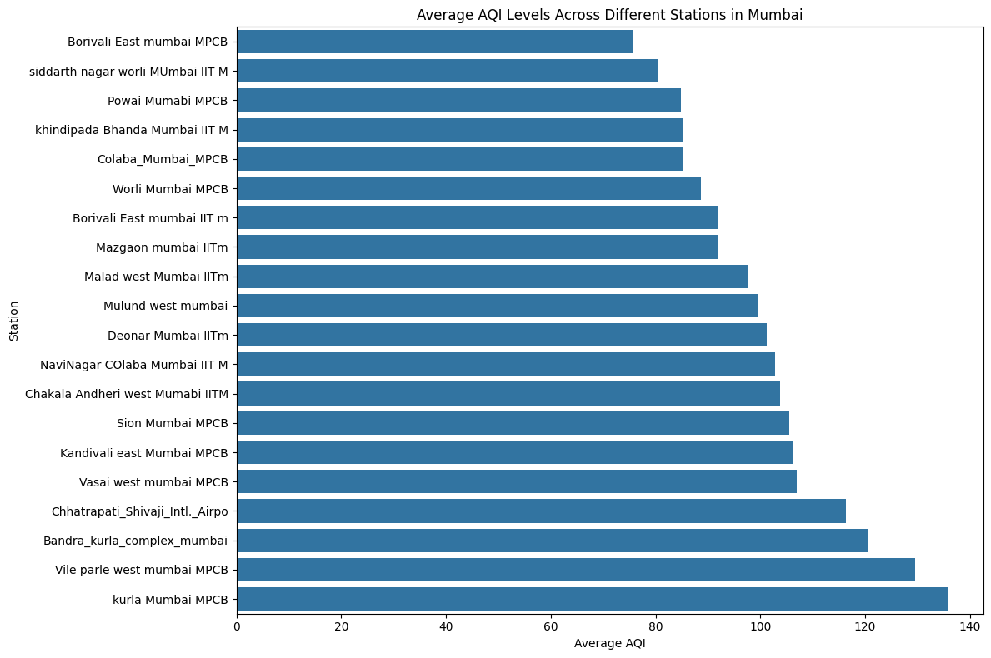
Average AQI levels across different stations in Mumbai

Slide 17
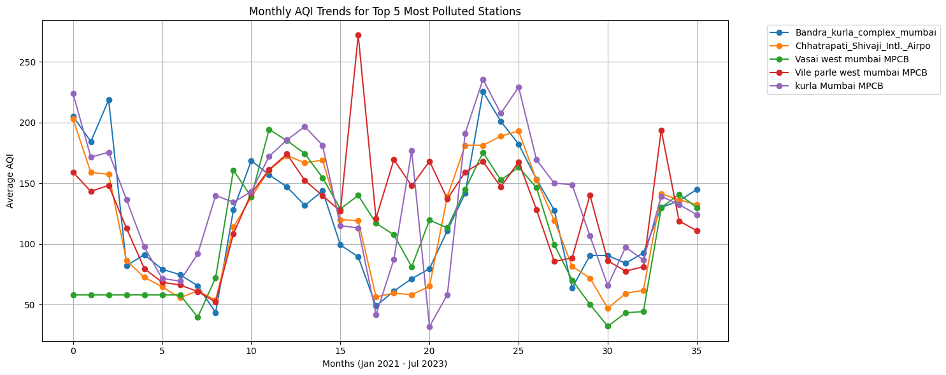
Monthly AQI trends for the top 5 most polluted stations
These Figure help to identify spatial and temporal pollution patterns effectively

Slide 18
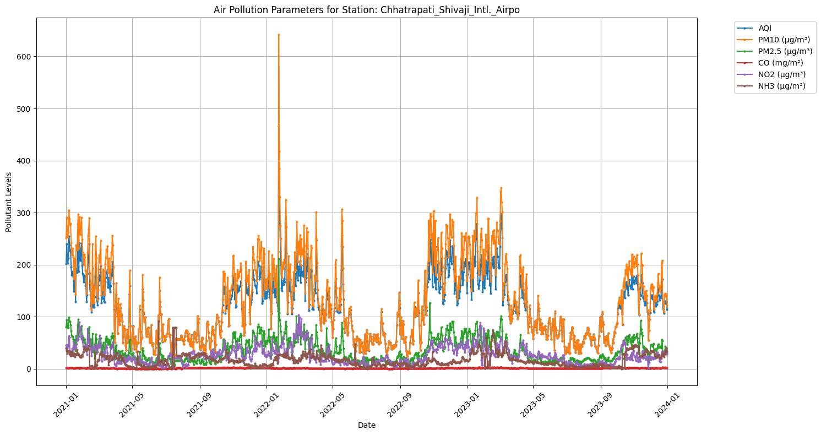
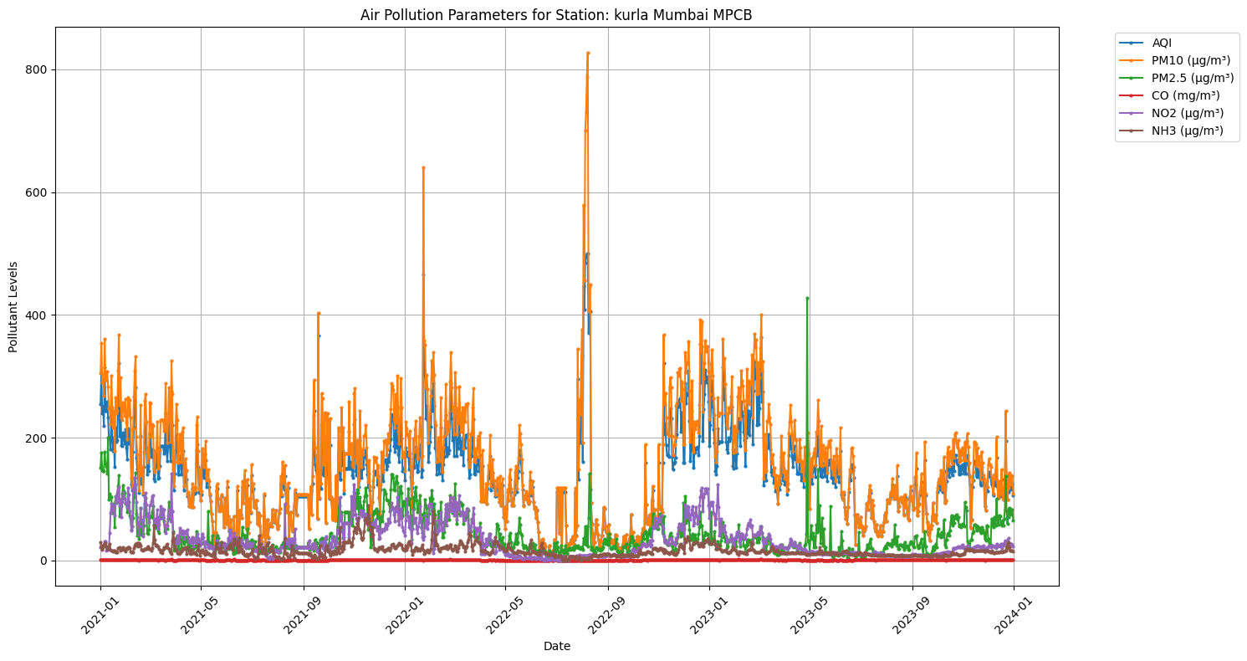
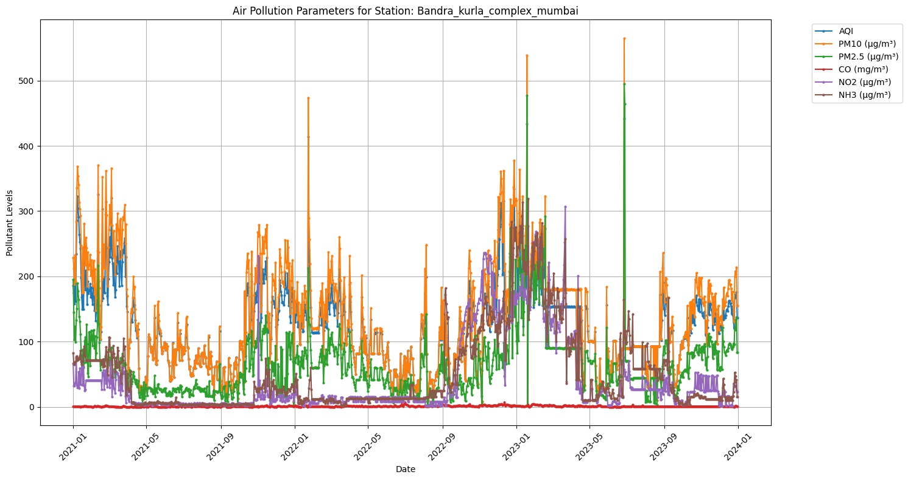
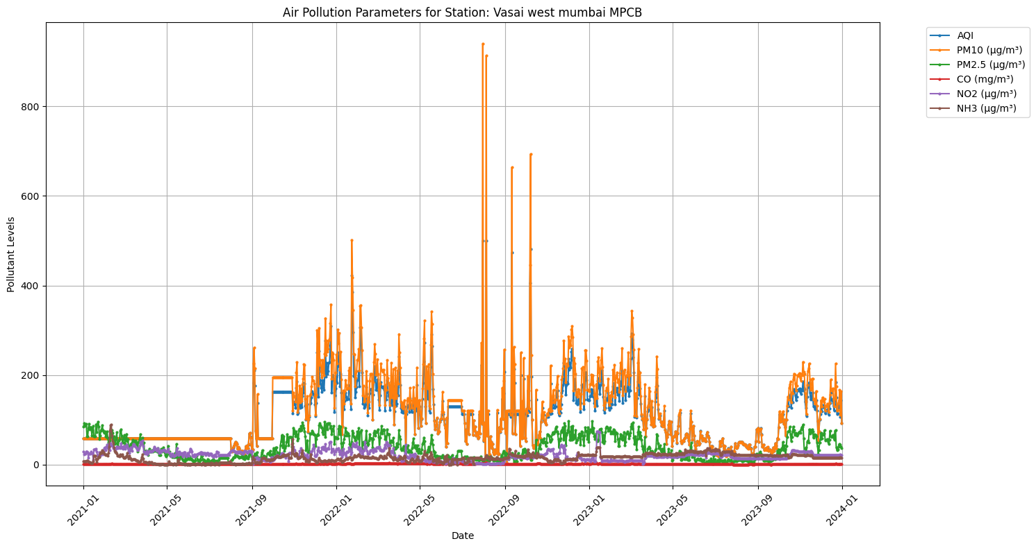
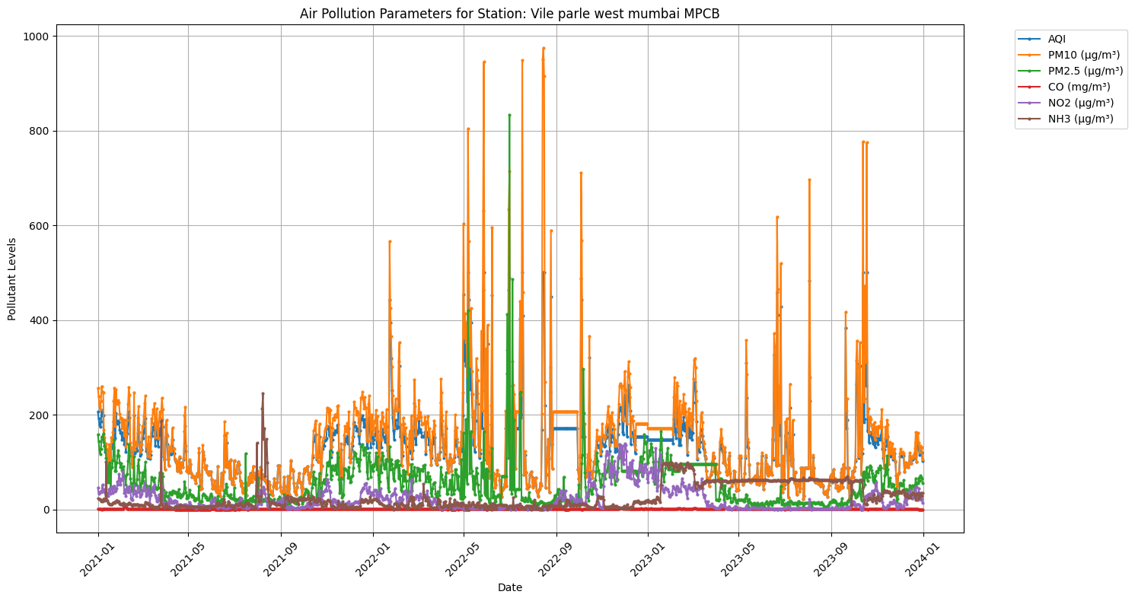
Pollution parameter trends using linechart : Air pollution parameter for top 5 most polluted stations

Slide 19
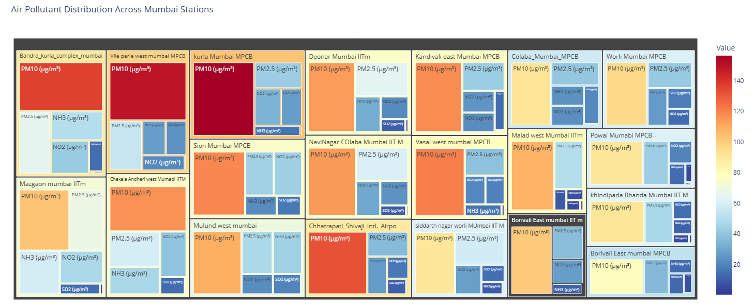
TreeMap for Air pollutant distribution across Mumbai stations

Slide 20
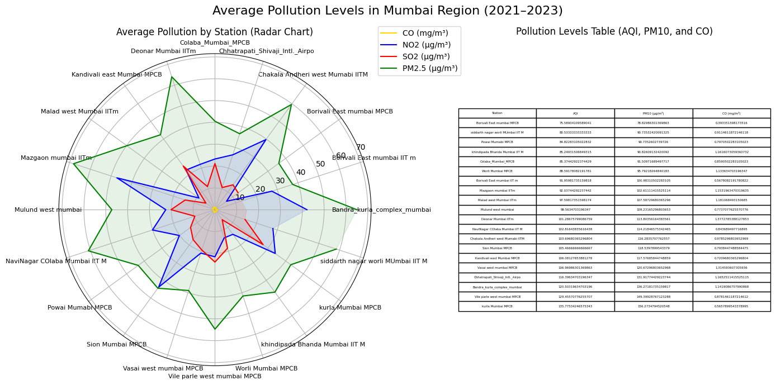
Table provides quantitative details for stations and pollutants, making it easy to analyze trends.
Radar chart of Average Pollution Levels Across 20 Stations in Mumbai
Together, these visualizations allow stakeholders to helps toIdentify stations with poor air quality and analyze the contribution of individual pollutants, it alsohelps to make decisions for targeted interventions to improve air quality in specific areas.

Slide 21
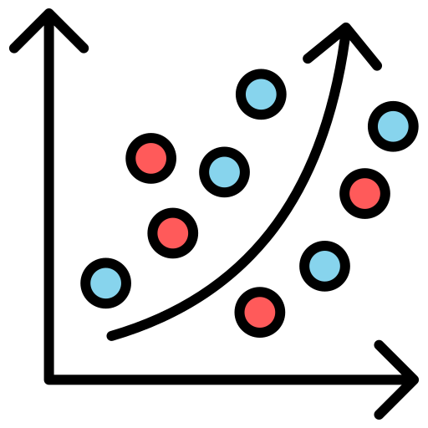




Model Development
Linear Regression: Builds a model to predict AQI based on a linear relationship between predictor variables and the target variable.
Decision Tree Regressor: Creates a model that splits data into subsets based on feature values, making predictions based on the majority class or average outcome in each subset.
Random Forest Regressor: Combines multiple decision trees to improve prediction accuracy and reduce overfitting by averaging their results.
Suport vector Regressor : SVM is an extension of SVC and used to separate nonlinear class classifier, SVM used kernel function to create non-linear Boundaries.
KNN Regressor: Predicts AQI by averaging the values of the nearest neighbors in the feature space, providing a non-parametric approach to modeling.

Slide 22
Model Evaluation & Feature Importance Model Evaluation & Freature selection will involve the following steps
Mean Absolute Error (MAE)
Mean Squared Error (MSE)
R-squared
Identifying Key Variables & Ranking Features
Measures the average magnitude of errors in predictions, providing an easy-to-understand metric of model accuracy.
Assesses the average squared difference between predicted and actual values, highlighting larger errors more significantly.
Indicates the proportion of variance in the dependent variable that is predictable from the independent variables, showing how well the model fits the data.
Understanding Evaluates which features (e.g., pollutants, weather conditions) have the most significant impact on AQI prediction.

Slide 23
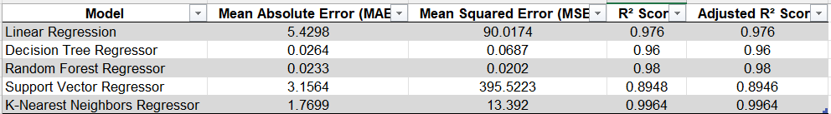
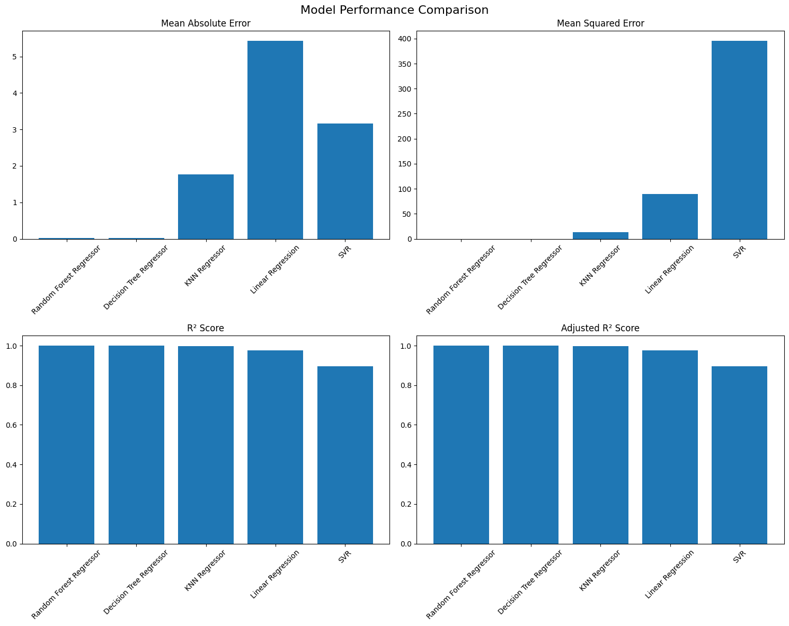

Slide 24
The best model based on the evaluation metrics is Random Forest Regressor, as it demonstrates the following:
Lowest Mean Absolute Error (MAE): 0.0233, indicating the smallest average difference between predicted and actual values.
Lowest Mean Squared Error (MSE): 0.0202, which minimizes large deviations.
Highest R² Score: 0.98, indicating it good fit to the data.
Adjusted R² Score: 0.98, maintaining its performance even after adjustments for model complexity.
While the Decision Tree Regressor also achieves excellent metrics, Random Forest Regressor typically generalizes better to unseen data due to its ensemble nature, making it the preferred choice.

Slide 27
Thank you..

